Slide 1
Innovative test solution
Provider
- Probe pin Datasheet -

Slide 2
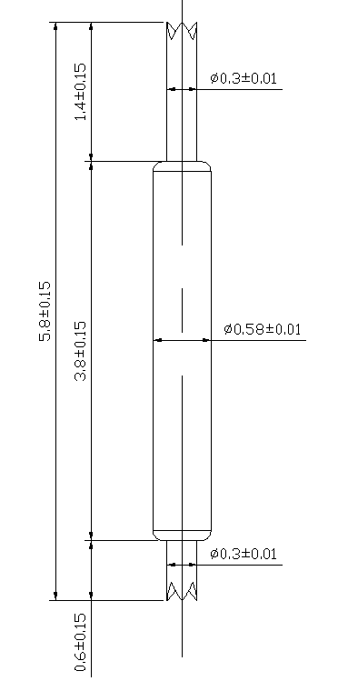
※ POGO type – 0.8 pitch
IVB-DCC-580-058-A223-00
Pitch | 0.8mm
Total Length | 5.8mm
Use Length | 5.0mm
Recommended Stroke | 0.8mm
Max Stroke | 1.0mm
Spring Force at Use Stroke | 25gf at 0.8mm Stroke
Operating Temperature | -40 to 125°C
DC Resistance | < 100.0mΩ at 0.8mm stroke
Current Rating | 3.0A
Self Inductance | TBD
Bandwidth @ -1dB | TBD
Capacitance | TBD
Top Plunger | BeCu / Au over Ni
Bottom Plunger | BeCu / Au over Ni
Barrel | Phosphor bronze / Au over Ni
Spring | Music Wire / Au over Ni
Insertion Life | 100,000 cycles at 0.4mm Stroke

Slide 3
Thank you.

